Slide 1

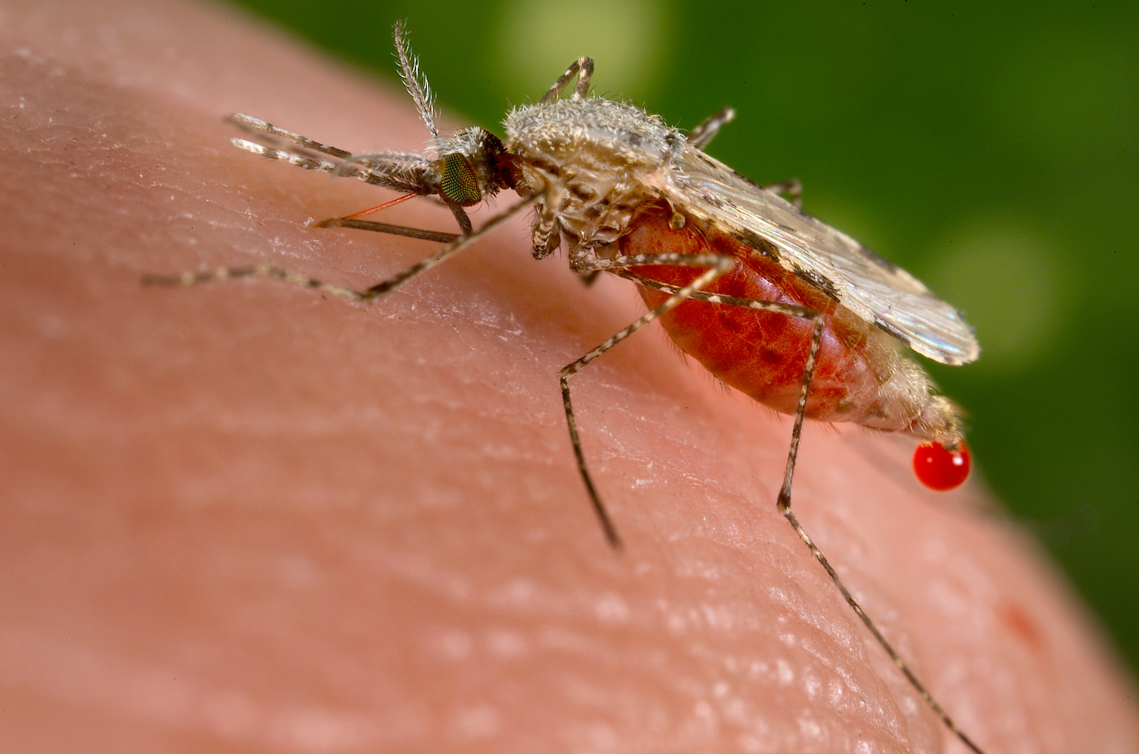

Group 4
Vallerian ,Violet Muscline, Godfrey
29.08.2025
Malaria Modelling with Vector Control and Treatment Interventions

Slide 2
Presentation Outline
Question
Flow Diagram of the question
Scenario 1:Vector Control
Scenario 2: Treatment
Scenario 3: Combined
Cost Effective Analysis
Policy Recommendation

Slide 3
Model Assumptions
The human Population is Closed and homogeneous
Individual Human Pop will recover without Immunity
People who don’t get effectively treated(outside 0.9) recover the natural way
Both the infected and treated people and Infected and untreated remain infectious until they recover
After the Latent Period the mosquito becomes Infectious and remain so until death.
Mosquitos birth rate and birth rate are equal

Slide 4
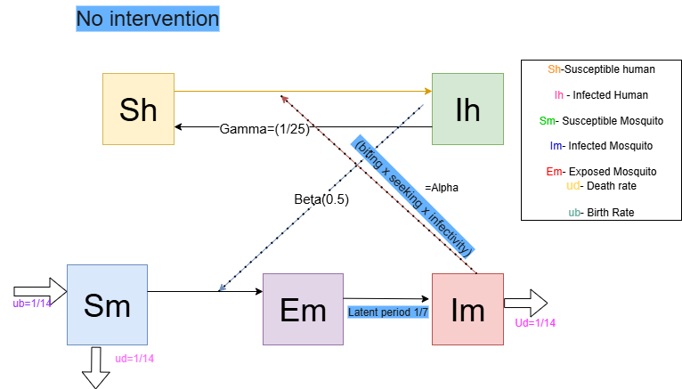
Flow Diagram – No Intervention

Slide 5
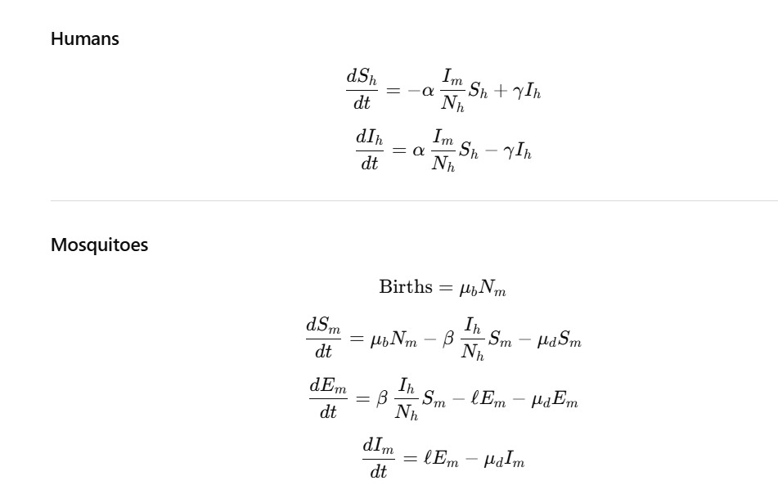
Differential Equations-No Intervention

Slide 6
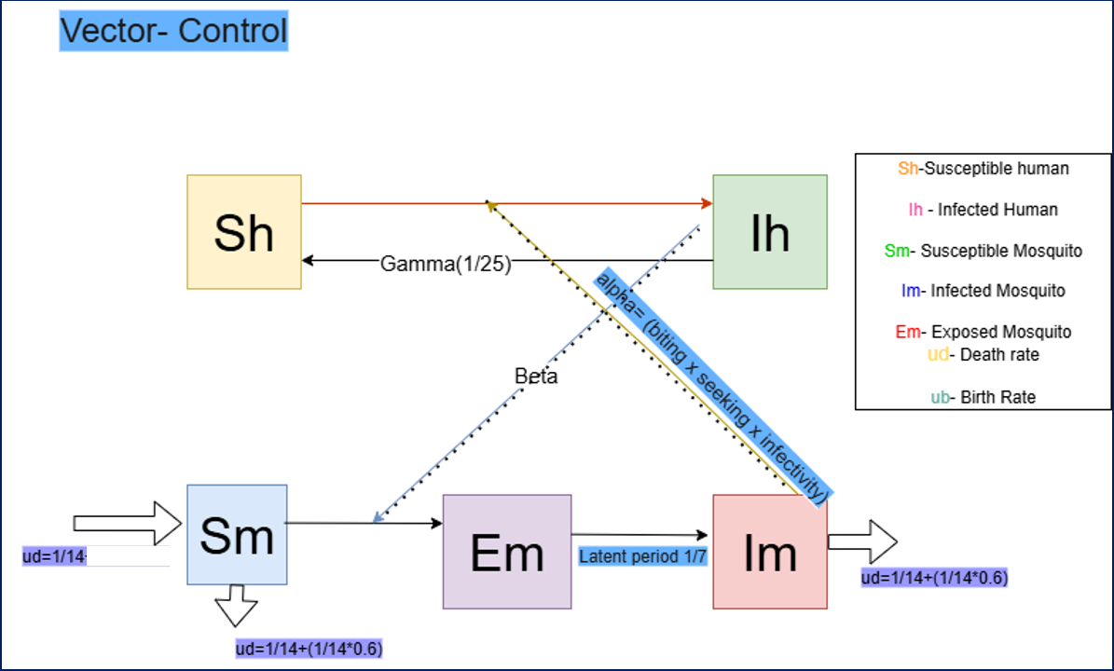

Slide 7
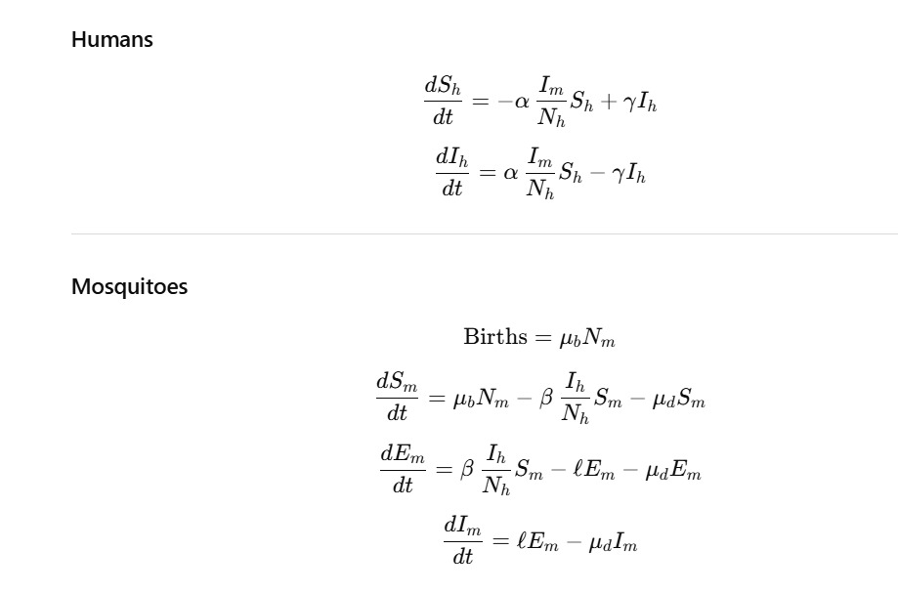
Differential Equations-Vector Control

Slide 8
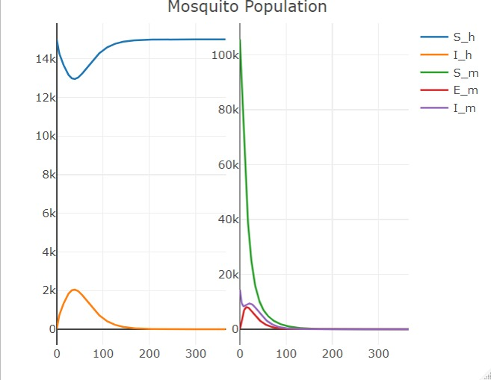
Vector Control Intervention Impact

Slide 9
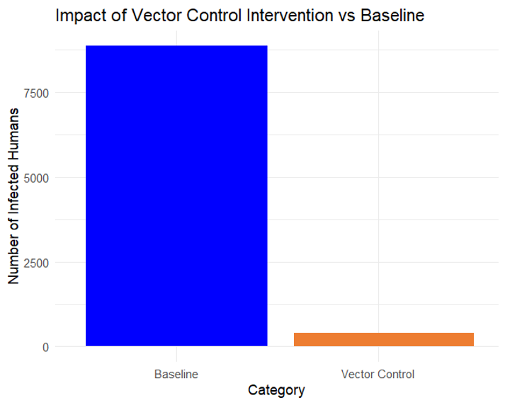
Cases Averted by Vector Control
Cases Averted by Vector Control >99%(n=8777))
Invest = $80,000

Slide 10
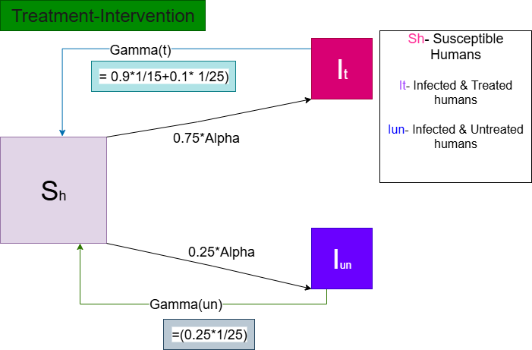

Slide 11
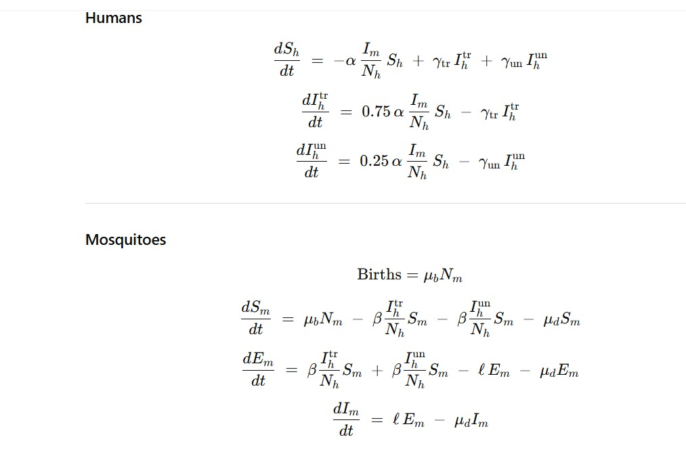
Differential Equations-Treatment

Slide 12
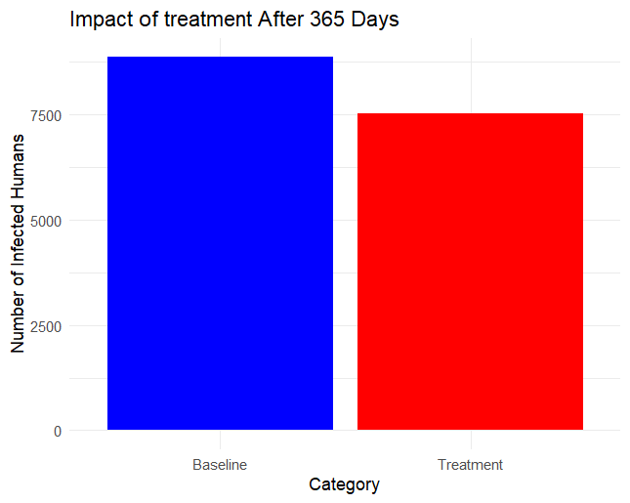
Cases Averted by Treatment
Cases Averted by Treatment 15%(n=8777))
Invest = $1,670,117

Slide 13
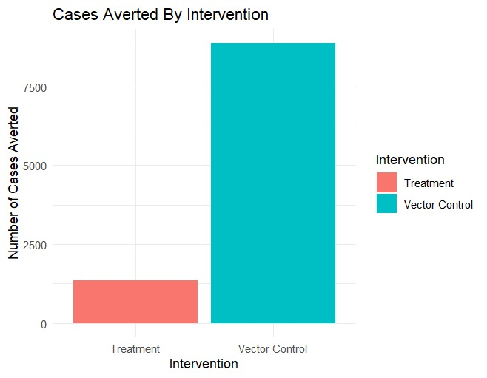
Policy Brief
VC= $80,000
T = $1,670,117

Slide 14
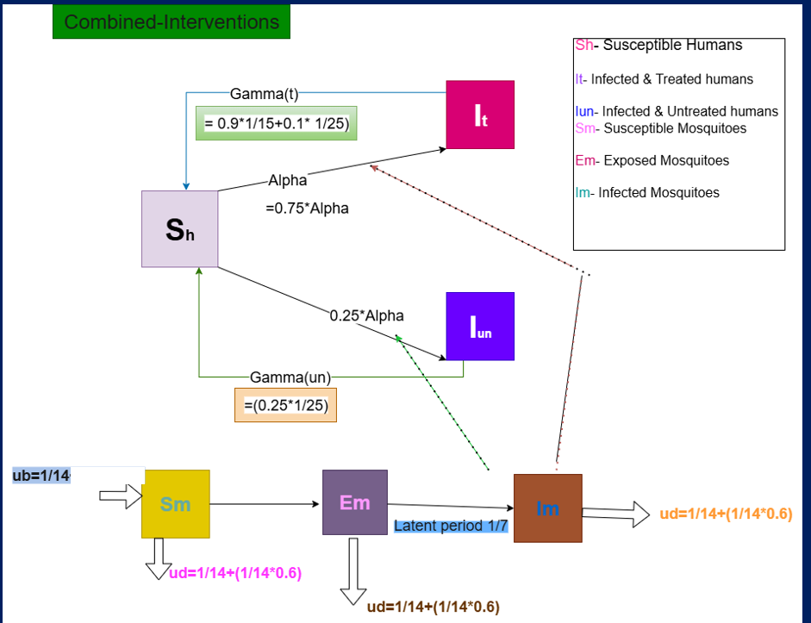

Slide 15


